Slide 1
Secure Programming

Slide 2
Software Development Lifecycle (SDLC)
Requirement
Design
Implementation
Testing
Deployment
Maintenance

Slide 3
Microsoft Security Development Lifecycle (Microsoft SDL)
Training
Design
Implementation
Verification
Release
Response
Requirement

Slide 4
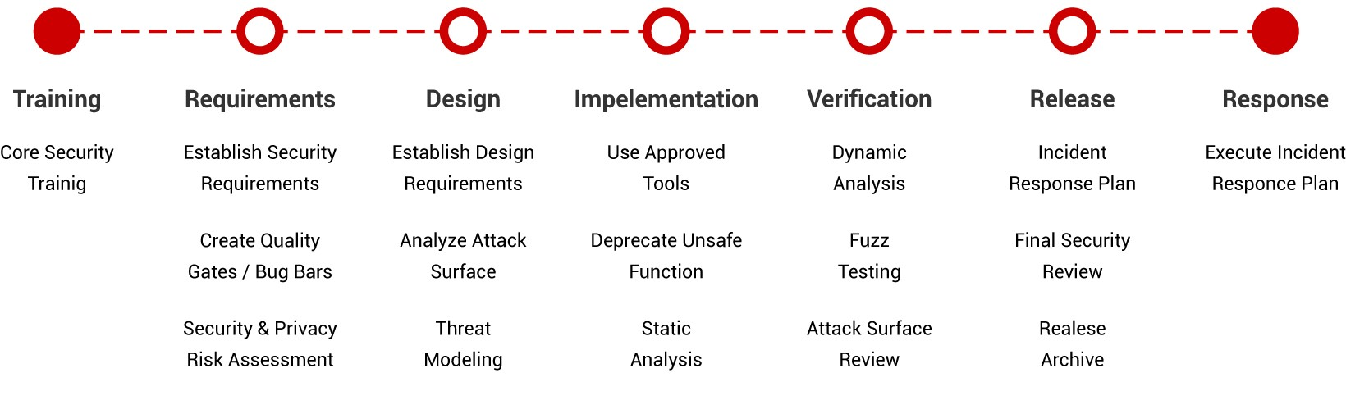
Microsoft SDL

Slide 5
SDLC Microsoft SDL
Requirement
Design
Implementation
Testing
Deployment
Maintenance
Training
Design
Implementation
Verification
Release
Response
Requirement

Slide 6
Phase#1 SDL: Security Training
Education Phase

Slide 7
Why You Need Secure Software
It has become increasingly crucial to guard and protect your personal information because there’s a lot out there​
Hard drives and disk space, with their large capacities, are becoming vital components in our everyday life​
Each time you expose your personal information to software (Web sites or other programs), the risk of fraud and theft increases

Slide 8
Why You Need Secure Software
Why is all this sensitive information stored?​
Data mining and data warehousing became a huge trend in the late 90’s​
Companies analyze their businesses more closely, looking for patterns and statistics in customer behavior​
The more data they have, the better analysis they can provide for future forecasting​

Slide 9
Why You Need Secure Software
Improving business practices through advanced technologies is a goal for most companies​
Tomorrow’s gadgets and widgets are going to be more custom designed to your personal tastes and preferences​
Businesses also feel that if they do not leverage their resources appropriately and buy into the latest technologies, their competitors will, and, thus, they will lose market share and profits​

Slide 10
Why You Need Secure Software
“Contact-less” payment systems​
These systems involve waving your payment device around a sensor rather than using the traditional card swipe and sign method​
This new method of purchasing products requires just a wave of a small wand and “poof,” you now own whatever you want​
It is scary to think what kind of sensitive information can be exposed through wireless signals wherever you walk​

Slide 11
What you have to know first?!
Know the Types of Attacks​
Social engineering attacks​
Attacks against the application’s software​
Attacks against the supporting infrastructure​
Physical attacks​

Slide 12
Attack types
Social engineering attacks
Attacks against the application’s software
Attacks against the supporting infrastructure
Physical attacks

Slide 13
Attack types
Social engineering attacks
Dumpster diving
Spam
Attacks against the application’s software
Attacks against the supporting infrastructure
Physical attacks
Phishing
Man in the middle
Password Guessing
Reply attack
ARP poisoning
TCP session hijacking
DNS poisoning

Slide 14
Attack types
Social engineering attacks
Attacks against the application’s software
Attacks against the supporting infrastructure
Physical attacks
Buffer overflow
SQL code injection
Back door
XSS

Slide 15
Attack types
Social engineering attacks
Attacks against the application’s software
Attacks against the supporting infrastructure
Physical attacks
DOS/DDOS
Virus
Worm
Trojans
logic bombs

Slide 16
Attack types
Social engineering attacks
Attacks against the application’s software
Attacks against the supporting infrastructure
Physical attacks
No security guys
Open doors

Slide 17
To prepare yourself and your code from attacks at all angels, you need to know how to include quality and security at every level of your job.
Apply Quality and Security at Every Level​

Slide 18
Ensuring Quality and Security in the Industry​
Industry leaders:​
ISO: International Organization for Standardization​
NIST: National Institute of Standards and technology

Slide 19
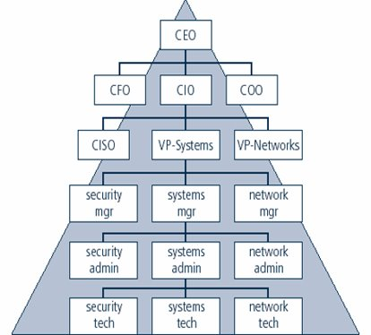
Ensuring Quality and Security in the Organization​

Slide 20
Ensuring Quality and Security in the Organization (continued)
Keep the C-class out of trouble​
CFOs without strong internal controls will be held accountable if something goes wrong and could be at risk for jail time​
Stakeholder needs​
If an attack occurs that tarnishes the reputation of the company, then the wrath of Wall Street and/or public
C.I.A. triad​
Confidentiality is assurance of data privacy​
Integrity is assurance of data non-alteration​
Availability is assurance of timely and reliable access to data services for authorized users' corn could ruin the company

Slide 21
Ensuring Quality and Security in the Cube
Know the enemy​
Prevent social engineering​
Clean up the clutter​
Stay current

Slide 22
Ensuring Quality and Security in the Cube (continued)
Know the enemy​
Know the weak areas of the application architecture and the areas attackers target most ​
Know who would want to attack your software and why they’d likely target​
Know what types of resources would be needed by the attackers, such as tools, privileges, and time slots​
Know how to build countermeasures

Slide 23
Ensuring Quality and Security in the Cube (continued)
Stay away from social engineering tactics​
Verify the identity of all callers​
If you do not recognize the caller and he or she is asking questions to extract sensitive information, ask for a phone number to return the call​
Give information only to well-known or clearly identified people​
Never give your password to anyone for any reason​
Watch out for shoulder surfers​

Slide 24
Ensuring Quality and Security in the Cube (continued)
Clean up the clutter​
No sticky notes​
No matter how many usernames and passwords you need to remember, don’t write them on paper and hide them on (or in) your desk​
Stay current on attacks​
Stay current by keeping informed of the latest software attacks​

Slide 25
!!!
There will always be someone bigger, better, and smarter than you​
Three things to anticipate the loss of data:​
Know what data is on the device​
Protect the data even when the device is lost​
Expect the device to be lost​

Slide 26
References
Secure Software Development: A Security Programmer’s Guide, First Edition​

